Slide 1
Deploying a MongoDB Replica Set in VirtualBox

Slide 2
Step 0: Precondition
Server | Replication Server Alias | IP Address | Port
1 | mongo1 | 192.168.56.101 | 27017
2 | mongo2 | 192.168.56.102 | 27017
3 | mongo3 | 192.168.56.103 | 27017
Replication Set Name
rs0
*Note: Each VM must be connected to a Host-Only Adapter Network

Slide 3
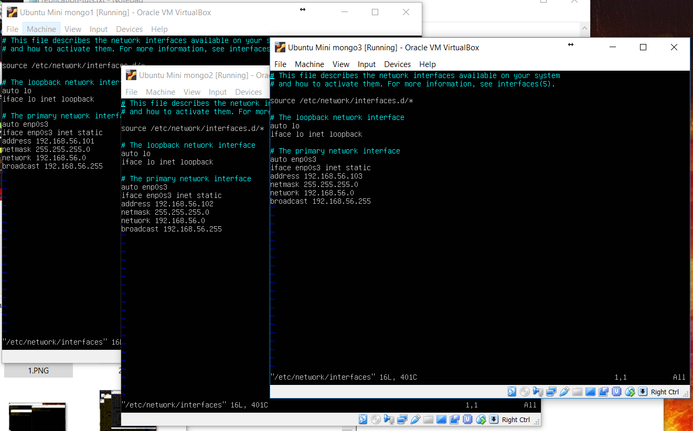
Step 1: Set Static IP Addresses for each Replication Server and their Aliases
In /etc/network/interfaces:

Slide 4
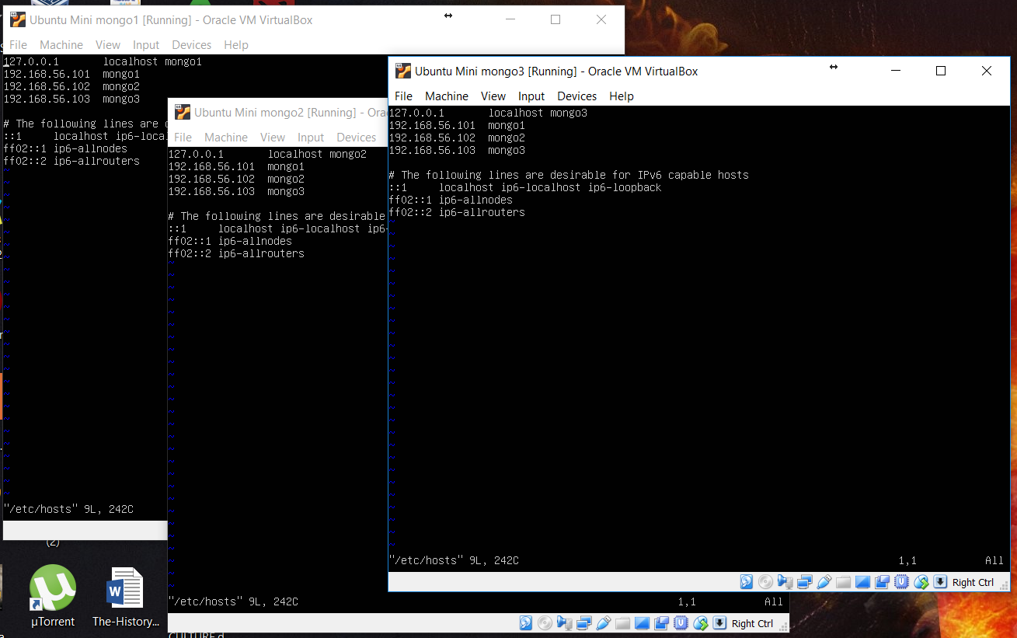
Step 1: Set Static IP Addresses for each Replication Server and their Aliases
In /etc/hosts:

Slide 5
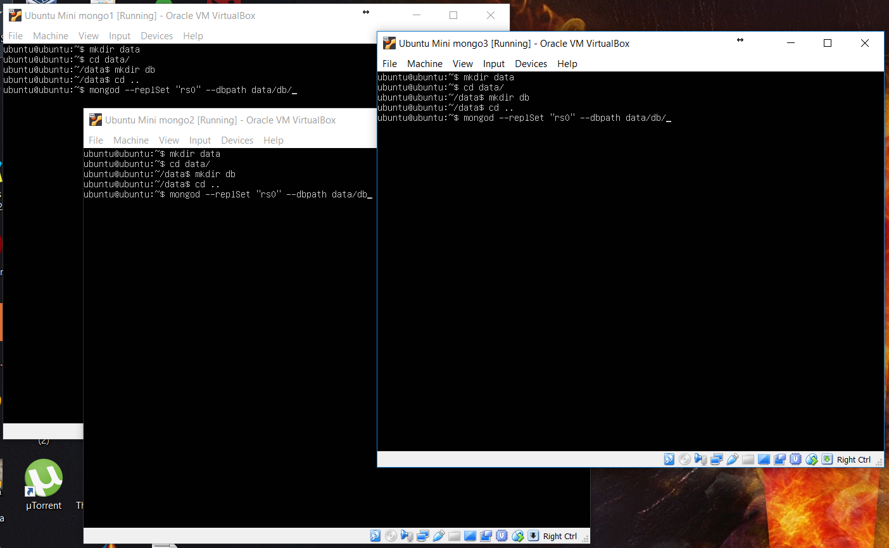
Step 2: Run mongod on each Replication Server
>> mongod --replSet “rs0” --dbpath data/db

Slide 6
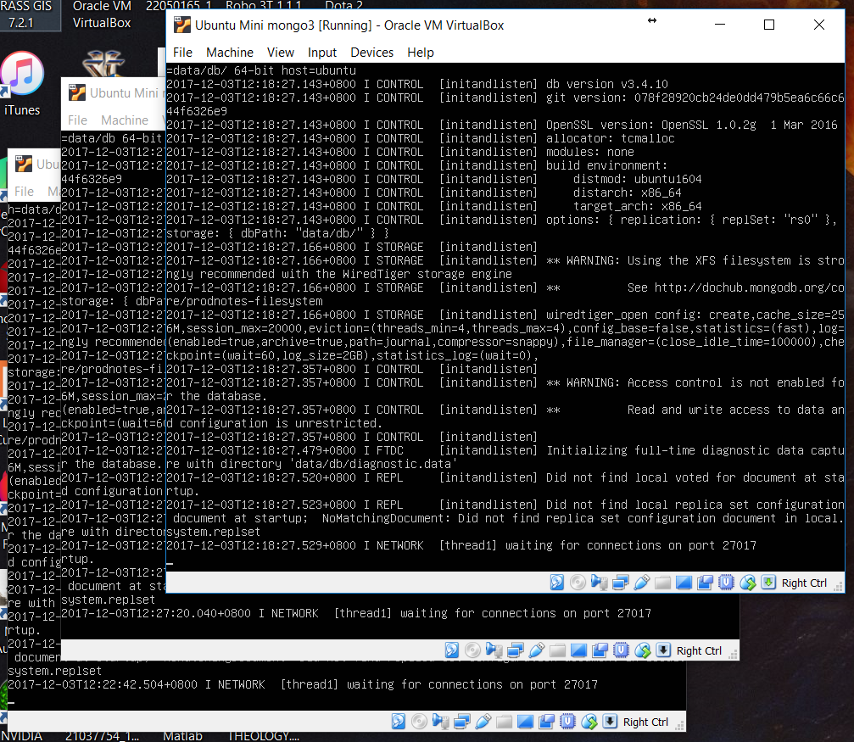
Step 2: Run mongod on each Replication Server
Expected result:

Slide 7
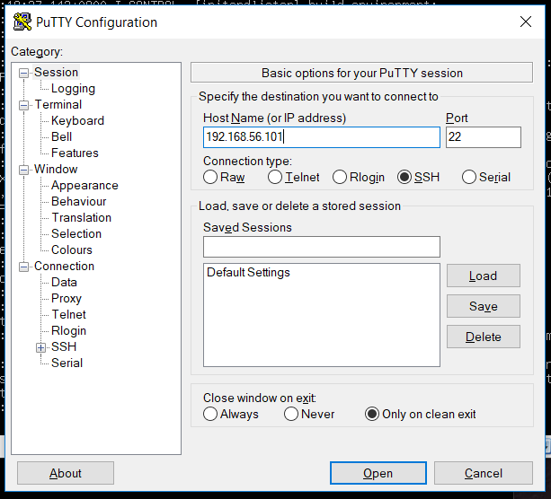
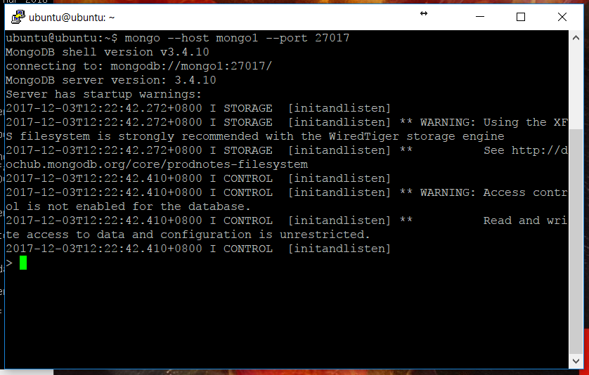
Step 3: Connect to one of the Replication Server using Putty and run mongo
>> mongo --host mongo1 --port 27017

Slide 8
Step 4: Initiate the Replication Set and add all included Replication Servers
>>
rs.initiate( {
_id : "rs0",
members: [
{
_id : 0,
host : "mongo1:27017",
}
]
})
>>
rs.add("mongo2")
rs.add("mongo3")

Slide 9
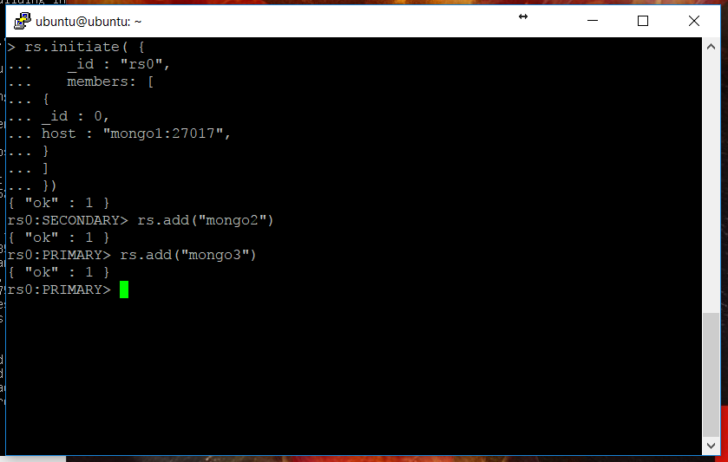
Step 4: Initiate the Replication Set and add all included Replication Servers
Expected result:

Slide 10
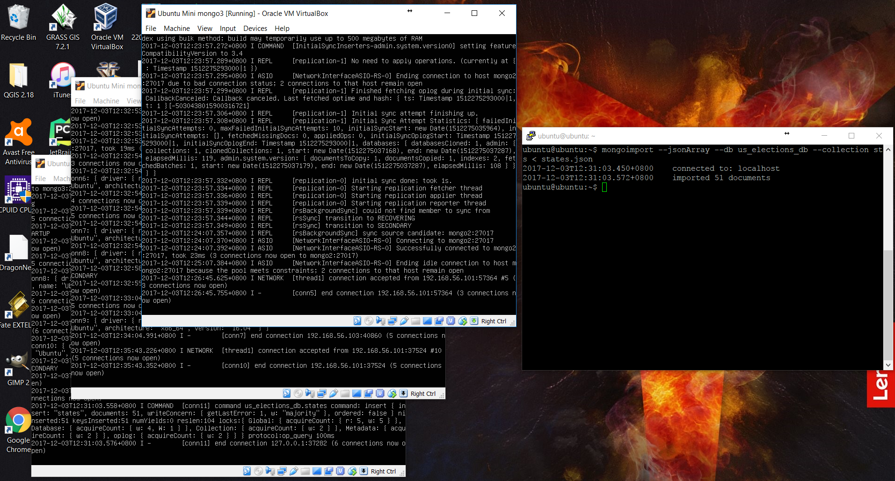
Step 5: Try to insert data

Slide 11

Step 6: Check if data is inserted

Slide 12
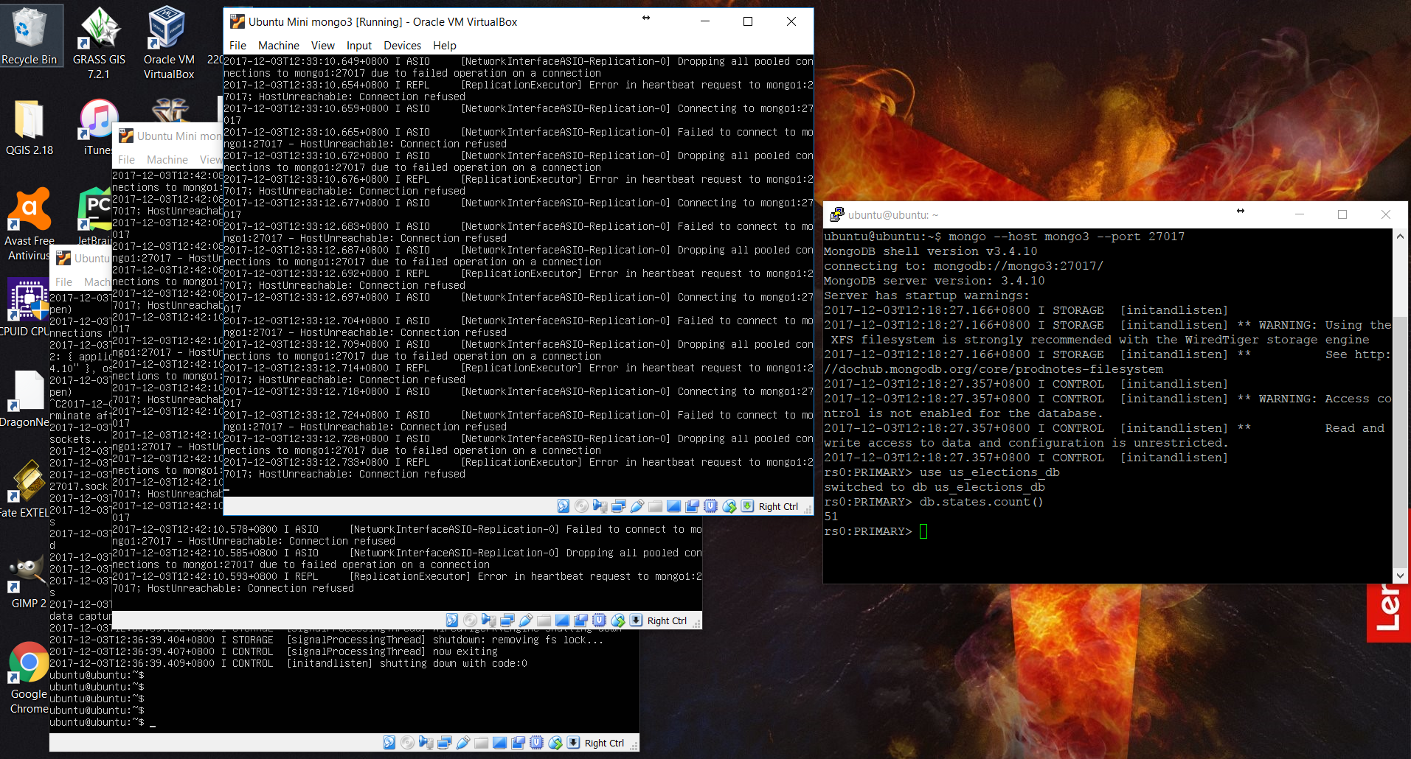
Step 7: Shutdown primary server, find the new primary server and check if data still exist

